Slide 1
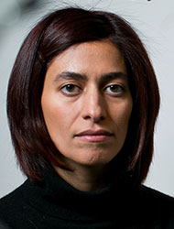
Nikta Fakhri
Notes:
# Name Nikta Fakhri # Textbook Knight, Physics for Scientists and Engineers: A Strategic Approach with Modern Physics, 3rd Edition, Chapter 18 # Description Nikta Fakhri joined the MIT Physics Department as an Assistant Professor in January 2015. She completed her undergraduate degree at Sharif University of Technology, Tehran, Iran and her PhD at Rice University. She was a Human Frontier Science Program postdoctoral fellow at Georg-August-Universistät in Göttingen, Germany before joining MIT. # Sources http://web.mit.edu/physics/people/faculty/fakhri_nikta.html # Photo http://web.mit.edu/physics/images/faculty/fakhri_nikta.jpg

